Slide 1




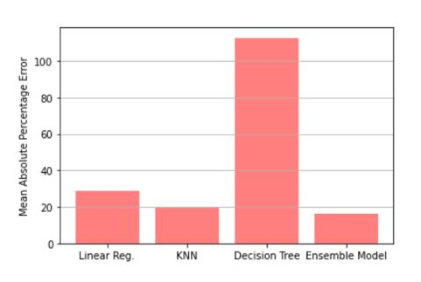
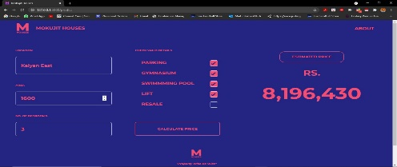
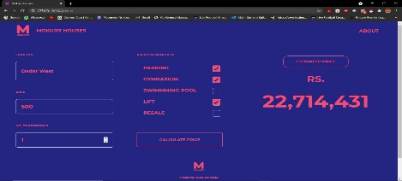
Project Title : House Price Prediction
Domain (Area of Project) : Machine Learning and AI
Name of Project Guide : Dr. Swati Sinha (swati.sinha@vit.edu.in)
Name of Students : Shefin Shajit (sheffinshajit@gmail.com)
Sushant Kulkarni (kulkarnisushant0408@gmail.com)
Akshay Mohite (akmohite1506@gmail.com)
Brief idea of Project :
In 2021, the sector must adopt innovative ways of dealing with the requirements. While houses will continue to be sold, they will now be done with creative disruption. The reinvention will include technology playing a lead role in meeting altered norms being considered by home buyers. The aim of the system is to help the user to make smart investment decisions while buying a house or find the accurate price of the house . The ensemble model incorporated in our system (weighted average of Decision Tree, Linear Regression, and K-Nearest Neighbor) brings an added advantage over using solo algorithms in the process of obtaining minimum error in prediction.
Screenshots of the Project / Photos of Working Model (Min.3):
Applications:
Estimate the price for a particular house considering the real-life factors.
Manage house parameters according to the ideal predicted price.
Awards/Participation if Any for TPP / Competitions / Paper Publication / Any Other Pls. Specify: --
Under process- waiting for acceptance status.
Notes:
DO NOT CHANGE ANY FONT TYPE AND SIZE ANYWHERE IN THE SLIDE.
Put Group ID in right bottom corner

